Slide 1

IST 261 (Fall 2019)
Application Development Design Studio I
JUnit – Part 2
Phil O'Connell
pxo4@psu.edu

Slide 2
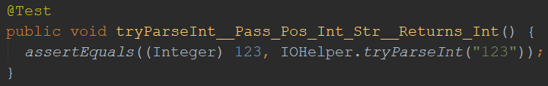
assertEquals
assertEquals accepts an expected value, and an actual value
If the values are equal, then it will pass the test
If not, then it will fail the test
We name this test method tryParseInt_ _Pass_Pos_Int_Str_ _Returns_Int
We're passing a positive integer string, and expect it to return an integer
expected
actual

Slide 3
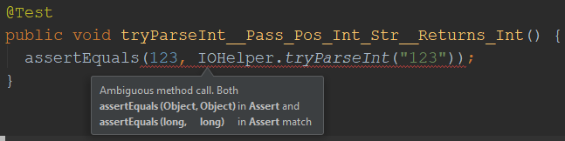
assertEquals
We casted the 123 value since assertEquals expects an object
And just 123 is a primitive
If we did not cast it to Integer, we'd get a build error

Slide 4
assertEquals
You don't always need to cast the expected value
For other types besides int, try coding without the casting
If you get a build error, then do the casting
There is also assertNotEquals to check the opposite

Slide 5
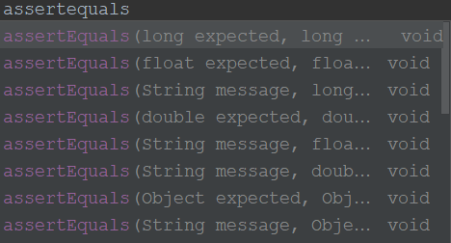
assertEquals
There are assertions for other primitives
But int is not one of them
This is what we used for int, and why we had to cast it to an Integer object

Slide 6
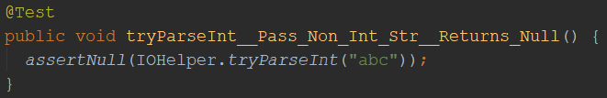
assertNull
We're passing a string that can't be converted to an int, so we expect null returned
assertNull accepts an actual value
If that value is null, then it will pass the test
We name this test method tryParseInt_ _Pass_Non_Int_Str_ _Returns_Null
actual

Slide 7
assertNull
This:
assertNull(IOHelper.tryParseInt("abc"));
Is virtually the same as this:
assertEqual(null, IOHelper.tryParseInt("abc"));
But it's more correct to use the specialized null assertion
You can also use assertNotNull to check the opposite

Slide 8
assertSame
assertSame accepts an expected value, and an actual value
If the values refer to the same object, then it will pass the test
If not, then it will fail the test
String expected = new Person();
String actual = expected;
// Will pass because expected and actual point to the same objects in memory
assertSame(expected, actual);

Slide 9
assertSame
assertSame accepts an expected value, and an actual value
If the values refer to the same object, then it will pass the test
If not, then it will fail the test
String expected = new Person();
String actual = new Person();
// Will fail because expected and actual point to different objects in memory
assertSame(expected, actual);

Slide 10
AssertSame is NOT equivalent to AssertEquals
With Java objects, == means "refer to the same object"
.equals() means "the objects have the same data inside"
Assertion | IsVirtually the Same As
assertEquals(expected, actual) | assertTrue(expected.equals(actual))
assertSame(expected, actual) | assertTrue(expected == actual)

Slide 11
assertEquals vs assertSame
Memory in the JVM
String greeting = "Hello";
String wassup = greeting;
// Will PASS
// Because greeting.equals(wassup)
assertEquals(greeting, wassup);
// Will PASS
// Because greeting == wassup
assertSame(greeting, wassup);
H
e
l
l
o

Slide 12
assertEquals vs assertSame
Memory in the JVM
String greeting = "Hello";
String wassup = new String("Hello");
// Will PASS
// Because greeting.equals(wassup)
assertEquals(greeting, wassup);
// Will FAIL
// Because greeting == wassup
assertSame(greeting, wassup);
H
e
l
l
o
H
e
l
l
o

Slide 13
When to Use Them?
Most of they time, you'll want assertEquals
Comparing the data contents
You may want assertSame if you're
Adding an object to a list, and want to test that you can find it later
Deleting an object from a list, then checking to ensure it's not there
There are probably more scenarios

Slide 14
By the way...
If your class doesn't have an equals method, then AssertEquals will call AssertSame behind the scenes
e.g., if you have a Person class that doesn't have a class-level public boolean equals(Object obj) method

Slide 15
By the way...
If you're dealing with primitives (int, float, double, etc), then AssertEquals will call AssertSame behind the scenes
Primitives don't have methods, so they don't have .equals()

